Slide 1
02. Needfinding
CS 337E: Design for Global Grand Challenges

Slide 2

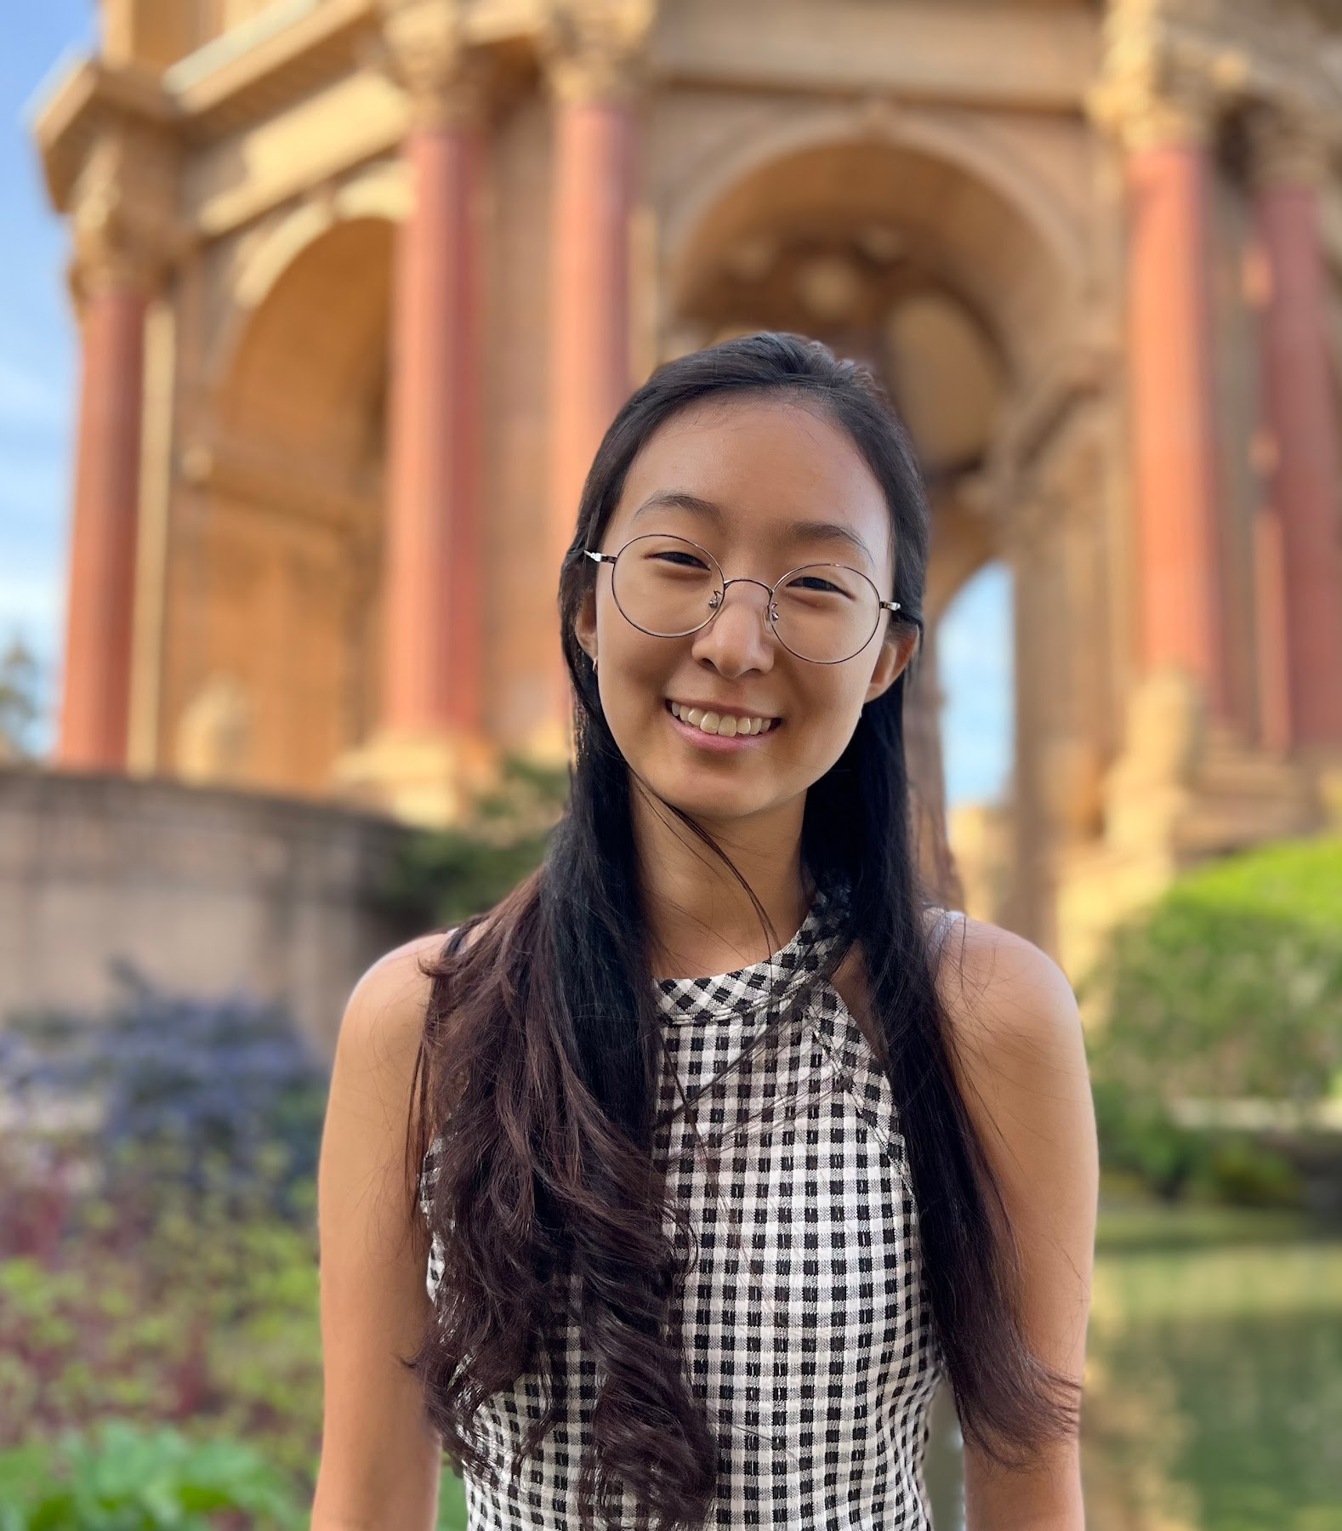

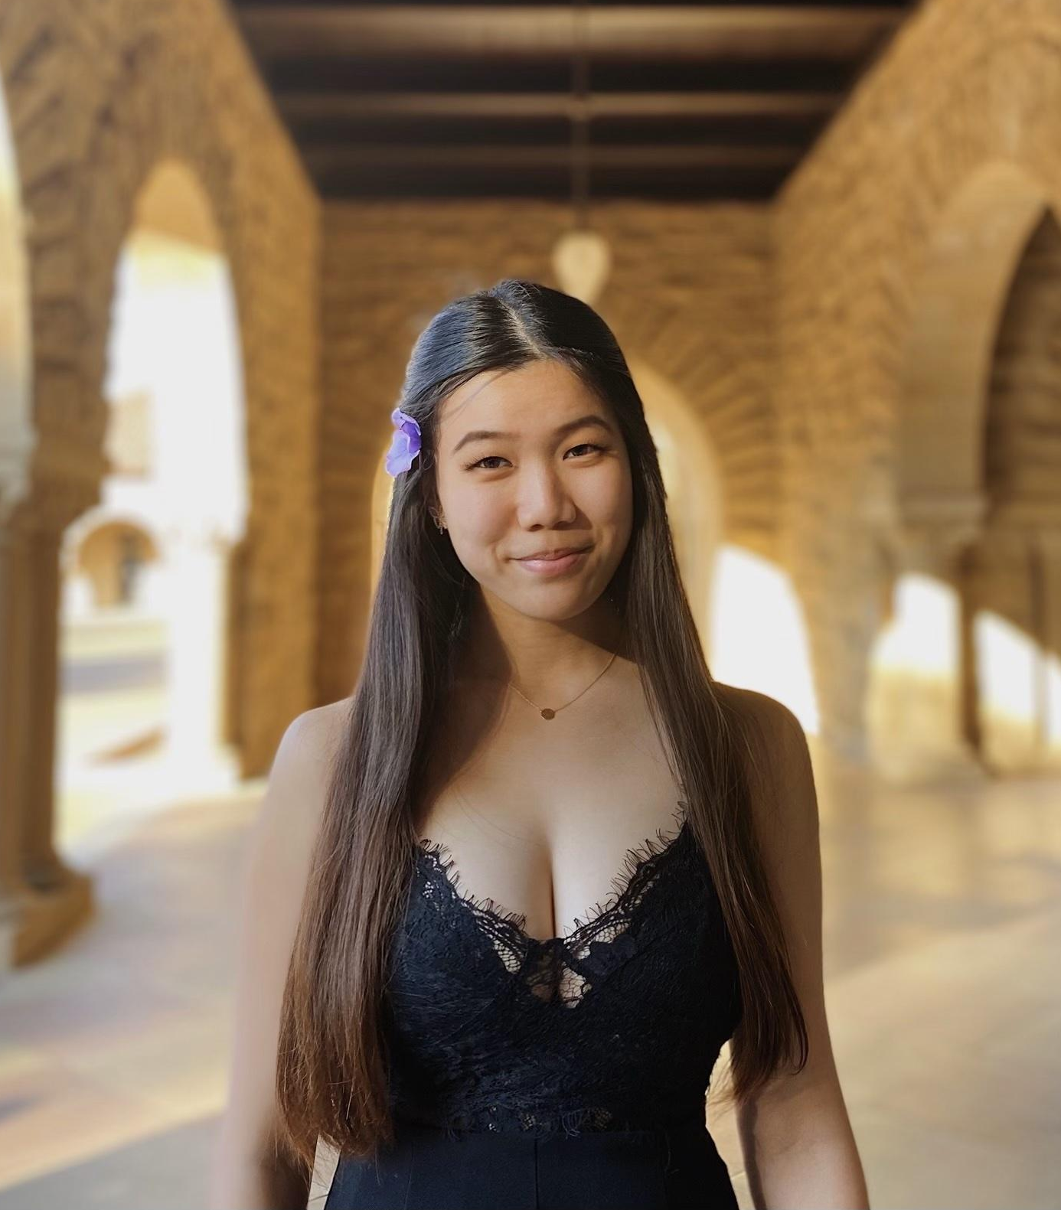
Team Mango
Homeschool Education
Nathan Marks
Christina Kwak
Claire Muscat
Grace Zhang
CS, AI Coterm
Econ, HCI Coterm
CS, HCI Coterm
CS, HCI Coterm

Slide 3


We conducted needfinding interviews with 8 individuals:
4 homeschooling parents (expert)
4 homeschooled individuals

Slide 4
Key Insights
Motivation to Homeschool
Methods of Teaching
Peers & Community
Agency vs. Authority

Slide 5



Insight 1:
Motivation to Homeschool
“Peer influence might have a greater influence than parents on children.” – P3
Different reasons for homeschooling
Religion
Competitive sport
Flexibility in pacing and opportunities
More direct parental influence
Reason for homeschooling can lead to vastly different experiences and outcomes for their children
“In homeschooling you really get to go your own pace and go fast if you get it or bring in fun things” – P2
“I feel like our public school system is mainly in place to serve parents. It’s convenient to drop your kid off because that serves the parents’ lifestyle. But I don’t think that’s a natural way to function as a child. It’s an artificial setting.” – P4

Slide 6
Insight 2:
Methods of Teaching
"Life is a learning laboratory." – P1
“You only learn by doing.” – S7
The methods of teaching vary widely:
Different teaching philosophies
Developing curriculum and materials
Online schooling
Exploration and field trips
Outsourcing to specialists
Focusing on the parents’ strengths
The interaction between the student and the parent/teacher is extremely important
Good feedback creates a positive learning environment
“The right amount of boredom is the breeding ground for creativity, but too much boredom is the breeding ground for trouble." – P1
“The really great thing about homeschooling was when and if I did find some outsourcing that was remarkable.” – P3
Notes:
Nathan add quote from Kristy

Slide 7
Insight 3:
Peers & Community
“What really got me into [Arts] was finding a wide variety of people and artistic artifacts I wanted to be able to also create, which I was exposed to because of meeting and talking with people; things like indie video games, exploring and being a part of communities of artists” – S3
There are a variety of ways that children can make friends while being homeschooled
Homeschooling co-op
Church / youth group, Scouts
Sports, Music, Extracurriculars
Personal outreach/interest groups
Important for kids to spend time with others their same age, with “different backgrounds, similar interests” to explore and foster their own passions
Cultivating home relationships and friendships with siblings
Struggles with forming deep connections before transitioning to public school
“Giving them the chance to cultivate relationships with their siblings instead of sending them off is a really big gift.” - P4
“I didn’t have that much trouble finding new friends or adapting. I had enough social experience. My mom did involve us with other communities pretty often. It wasn’t the first time I was involved in group dynamics.” – S1

Slide 8
Insight 4:
Agency vs. Authority
“When it’s just me [instructing my daughter], I think she feels like, ‘Oh, Mom’s just telling me what to do.’ She loves the content-based subjects, but with the skill-based subjects, it’s just a little harder to get the buy-in with her.” – P4
Balance between student agency and parental authority
Parents must decide how much autonomy to give their children in the learning process
Ongoing calibration while children find independence and interests
Recurring theme: importance of attitude toward learning
Downsides: potential for unhealthy power dynamics that have negative impacts on education and relationships
“Parents say: you’re my kid. I know what’s best for you. But they forget that the kid needs to have some agency in the process as well.” – S3
“The love of learning will be tanked if the child does not have bedrock of respect for authority in their life.” – P3

Slide 9
Questions?

Slide 10
Key Insights
Motivation to Homeschool
Methods of Teaching
Peers & Community
Agency vs. Authority

Slide 11
Empathy Maps
https://miro.com/app/board/uXjVMT65a3s=/?share_link_id=440017735351

